Slide 1
Web Services Overview

Slide 2
Agenda
Introduction
Variable Declaration
Constants
Arrays
Conditional and Looping Statements
Shell Scripting
Dictionary Objects
Functions
File Handling
Database Handling
Working with XML & Excel

Slide 3
Objectives Webservice
Web services
Software components that can be run over the Internet using XML
Reasons to use Web services
Applications can be built that are platform-independent, distributed, and secure
Technologies
XML, UDDI, WSDL, and SOAP
Web Services Architecture (WSA)
Set of protocols that solve the problems that every distributed application faces
The Java API for XML Parsing (JAXP) overview
The Java API for XML Binding (JAXB) overview

Slide 4
Web services
Definition:
Software components that can be published, located, and run over the Internet using Extensible Markup Language (XML)
Used to:
Allow other applications to call modules of code remotely with XML
Expose data in a database as XML
Send XML messages

Slide 5
Extensible Markup Language (XML)
Definition:
A markup language that describes data in a structured and human-readable text format
Example: <pilot> <name>Craig Duncan</name> <status>student</status> <hours type=“dual”>37.3</hours> </pilot>
Related to HTML, but more powerful because XML can be modified and extended
Has become the de facto standard for representation of information content
Has become the language of choice for information exchange

Slide 6
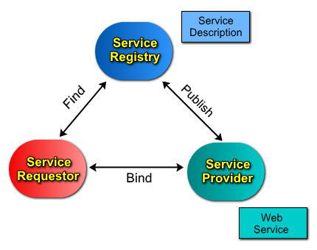
Web services Architecture
Note: Simple Object Access Protocol (SOAP) is an XML message format

Slide 7
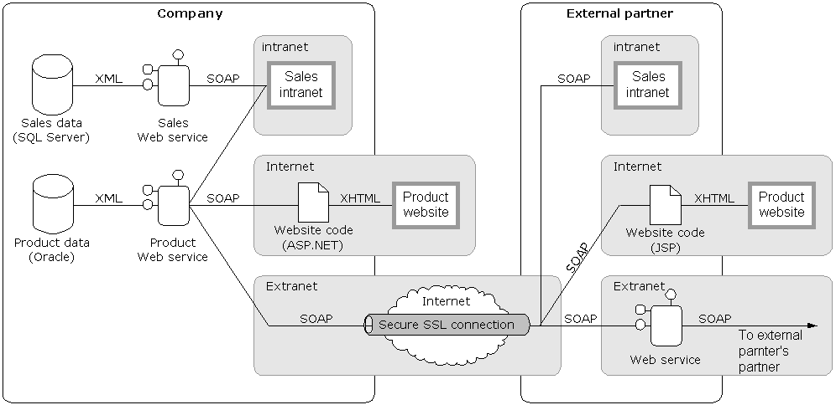
Web services diagram
Note: Simple Object Access Protocol (SOAP) is an XML message format

Slide 8
Reasons to use Web services
Applications can be built that are:
Platform-independent
Distributed
Secure
Web services will become the common architecture for system and application integration
Based on open industry standards
Companies and government agencies will be able to easily communicate with customers and external partners

Slide 9
More reasons to use : Web services
Loosely-coupled and flexible systems are more useful than hard-wired and monolithic ones:
Example – World Wide Web
Service Oriented Architecture (SOA)
Companies and government agencies will be able to access software remotely that they or others have already built (reuse)
Organizations will be able to extend the life and value of legacy systems by exposing existing data as XML

Slide 10
Even more reasons to use : Web services
Developers will be able to integrate applications:
Quickly
Easily
Inexpensively
Software development and maintenance time will be reduced
Increase efficiency 30% – Gartner
Data can be secured using industry standard security methods:
Secure Socket Layer (SSL) protocol
Public-key certificates
WS-Security

Slide 11
Web services issues
Not a silver bullet
Web services provide plumbing between applications
However, plumbing is essential
Easy to write, hard to get right
Distributed and asynchronous software is the hardest to develop and debug
However, not impossible
XML is wordy
Takes up a lot of processor time and bandwidth
However, up to a 90% compression ratio

Slide 12
Web services technologies(all based on XML)
Name | Abbreviation | Use
Extensible Markup Language | XML | Language
Universal Description, Discovery, and Integration | UDDI | Discovery
Web Services Description Language | WSDL | Description
Simple Object Access Protocol | SOAP | Request and receive messages

Slide 13
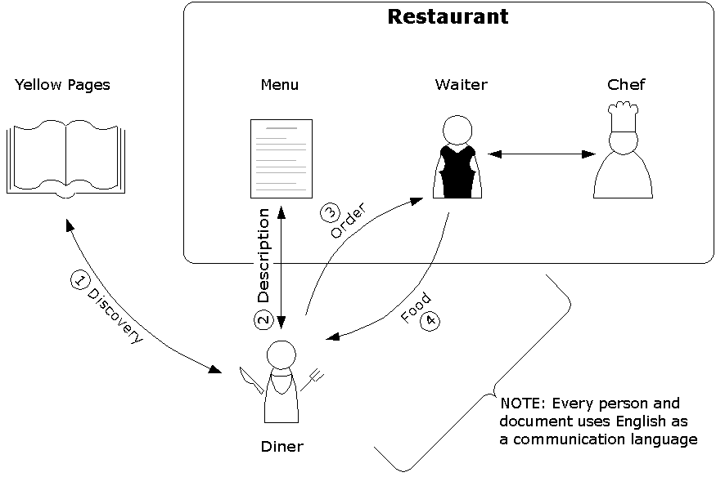
Ordering at a restaurant diagram

Slide 14
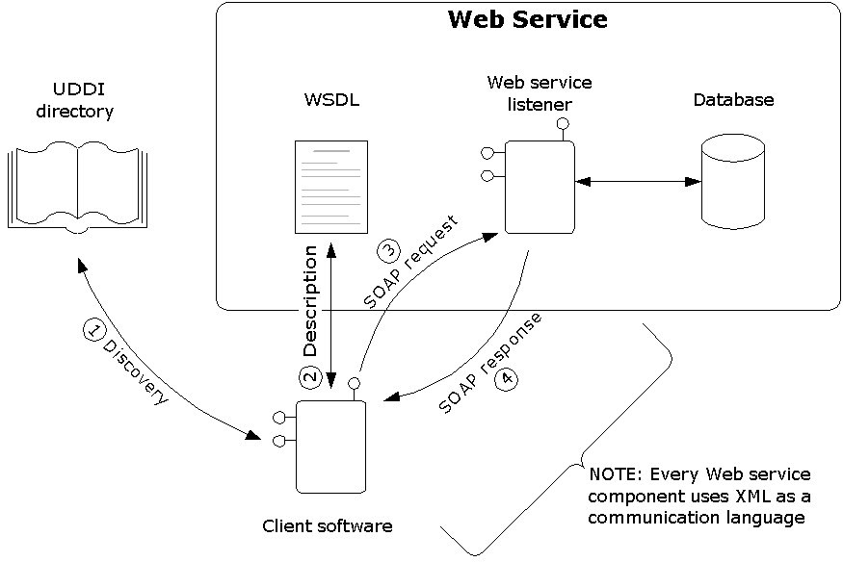
Calling a Web service diagram

Slide 15
Universal Description, Discovery, and Integration (UDDI)
“Discovery”
Web service equivalent of the Yellow Pages
Organizations register their Web services in a global directory so clients can find them
The hype:
Applications will be able to dynamically discover new Web services and automatically call them
The reality:
Provides a layer of software abstraction between Web services and client applications
Example – The URL address of a Web service changes
UDDI is a Web service (uses XML and SOAP)

Slide 16
Universal Description, Discovery, and Integration (UDDI) continued
Root UDDI directory
www.uddi.org
Other directories exist:
uddi.microsoft.com
uddi.ibm.com
www.xmethods.net
www.salcentral.com
Organizations can set up their own UDDI servers for internal use
Similar to an office telephone list

Slide 17
Web Service Description Language (WSDL)
“Description”
Web service equivalent of a menu
Uses XML to describe what the Web service can do:
Interface information (available functions)
Function data types
Function location information (URL address)
Choice of application transfer protocol

Slide 18
Simple Object Access Protocol (SOAP)
“Request and receive messages”
Web service equivalent of an order
A Remote Procedure Call (RPC)that consists of XML sent over HTTP
Other transport protocols can be used
Similar in structure to a letter:
A message is written in XML
The message is wrapped in an XML envelope

Slide 19
Sample SOAP request message
<?xml version="1.0" encoding="UTF-8" ?>
<soap:Envelope xmlns:soap=
"http://schemas.xmlsoap.org/soap/envelope/">
<soap:Body>
<GetAirportInformation>
<AirportIdentifier>N99</AirportIdentifier>
</GetAirportInformation>
</soap:Body>
</soap:Envelope>

Slide 20
Sample SOAP response message
<?xml version="1.0" encoding="UTF-8" ?>
<soap:Envelope xmlns:soap=
"http://schemas.xmlsoap.org/soap/envelope/">
<soap:Body>
<GetAirportInformationResponse>
<GetAirportInformationResult>
<Name>Brandywine Airport</Name>
<Location>West Chester, PA</Location>
<Length unit="feet">3347</Length>
</GetAirportInformationResult>
</GetAirportInformationResponse>
</soap:Body>
</soap:Envelope>

Slide 21
Distributed application problems
Developers writing distributed applications need a way to provide:
Security
Message integrity
Message confidentiality
Authentication
Authorization
Non-repudiation
Reliability
Transactions
Etc.

Slide 22
WS-Security
The most important WSA security protocol because the other security protocols use it
Provides message integrity:
XML Signature
Uses an algorithm to create a message digest
The recipient compares the digest to the message
The digest needs to be encrypted
Security tokens (identity authentication)
Username and password (needs SSL or VPN)
X.509 certificate
Kerberos ticket
Provides message confidentiality:
XML Encryption
Security tokens (same as above)

Slide 23
Sample SOAP message with WSA information in the header
<?xml version="1.0" encoding="UTF-8" ?>
<soap:Envelope
xmlns:soap="http://schemas.xmlsoap.org/soap/envelope/"
xmlns:ds="http://www.w3.org/2000/09/xmldsig#">
<soap:Header>
<m:path xmlns:m="http://schemas.xmlsoap.org/rp">
<m:action>http://ws.c3daero.com/getairportinformation</m:action>
<m:to>soap://c3daero.com/airports</m:to>
<m:from>mailto:craig.duncan@c3daero.com</m:from>
<m:id>uuid:84b9f5d0-33fb-4a81-b02b-5b760641c1d6</m:id>
</m:path>
<wsse:Security
xmlns:wsse="http://schemas.xmlsoap.org/ws/2002/04/secext">
<ds:Signature>
<ds:SignatureValue>DJbchm5gK...</ds:SignatureValue>
...
</ds:Signature>
</wsse:Security>
</soap:Header>
<soap:Body id="MsgBody">
...
</soap:Body>
</soap:Envelope>

Slide 24
Web service organizations
Standards organizations:
World Wide Web Consortium (W3C)
Web Services Interoperability Organization (WS-I)
Organization for the Advancement of Structured Information Standards (OASIS)
Vendors:
Microsoft
IBM
Sun Microsystems
Companies exposing data as Web services:
Amazon.com
Google
Companies writing Web services for the aviation industry
C3D Aero

Slide 25
The Java API for XML Processing (JAXP)
The Java API for XML Processing (JAXP) is for processing XML data using applications written in the Java programming language.
It provides the capability of validating and parsing XML documents. The three basic parsing interfaces are:
The Document Object Model parsing interface or DOM interface
The Simple API for XML parsing interface or SAX interface
The Streaming API for XML or StAX interface (part of JDK 6; separate jar available for JDK 5)
In addition to the parsing interfaces, the API provides an XSLT interface to provide data and structural transformations on an XML document.

Slide 26
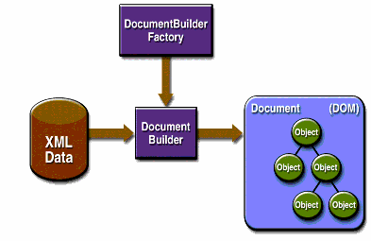
DOM interface
The DOM interface is perhaps the easiest to understand. It parses an entire XML document and constructs a complete in-memory representation of the document.
The DOM parser is called a DocumentBuilder, as it builds an in-memory Document representation. The javax.xml.parsers.DocumentBuilder is created by the javax.xml.parsers.DocumentBuilderFactory. The DocumentBuilder creates an org.w3c.dom.Document instance, which is a tree structure containing nodes in the XML Document.
DEMO

Slide 27
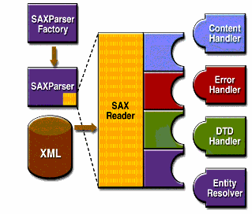
SAX interface
The SAX parser is called the SAXParser and is created by the javax.xml.parsers.SAXParserFactory.
Unlike the DOM parser, the SAX parser does not create an in-memory representation of the XML document and so is faster and uses less memory.
Instead, the SAX parser informs clients of the XML document structure by invoking callbacks, that is, by invoking methods on a org.xml.sax.helpers.DefaultHandler instance provided to the parser.

Slide 28
SAX interface . . . . . contd
The most important methods in this interface are:
startDocument() and endDocument() methods that are called at the start and end of a XML document.
startElement() and endElement() methods that are called at the start and end of a document element.
characters() method that is called with the text data contents contained between the start and end tags of an XML document element.
DEMO

Slide 29
The Java API for XML Binding (JAXB) overview
Java Architecture for XML Binding (JAXB) allows Java developers to map Java classes to XML representations.
JAXB provides two main features: the ability to marshal Java objects into XML and the inverse, i.e. to unmarshal XML back into Java objects.
In other words, JAXB allows storing and retrieving data in memory in any XML format, without the need to implement a specific set of XML loading and saving routines for the program's class structure.
Marshall Demo
UnMarshall Demo

Slide 30
Summary
Web services
Software components that can be run over the Internet using XML
Reasons to use Web services
Applications can be built that are platform-independent, distributed, and secure
Technologies
XML, UDDI, WSDL, and SOAP
The Java API for XML Processing (JAXP) is for processing XML data using applications written in the Java programming language.
Java Architecture for XML Binding (JAXB) allows Java developers to map Java classes to XML representations.

Slide 31
Quiz
Difference between SAX and DOM
WSDL stands for ________________________
State purpose of following terms involved in web service
UDDI
SOAP
XML
WSDL
Purpose of
JAXB Marshalling
JAXB UnMarshalling

